Slide 1
Introduction to xml
Xml extensible markup language
defined by: World Wide Web Consortium (W3C)

Slide 2
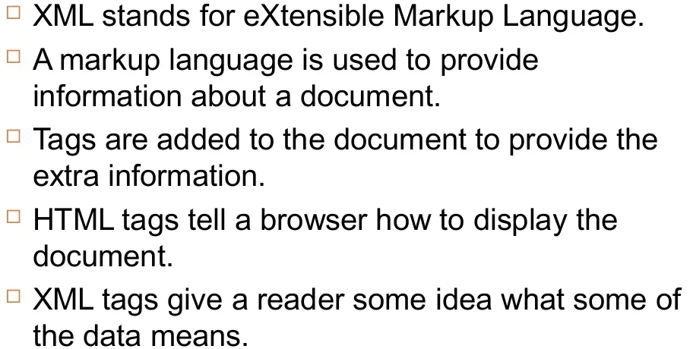
What is XML?

Slide 3
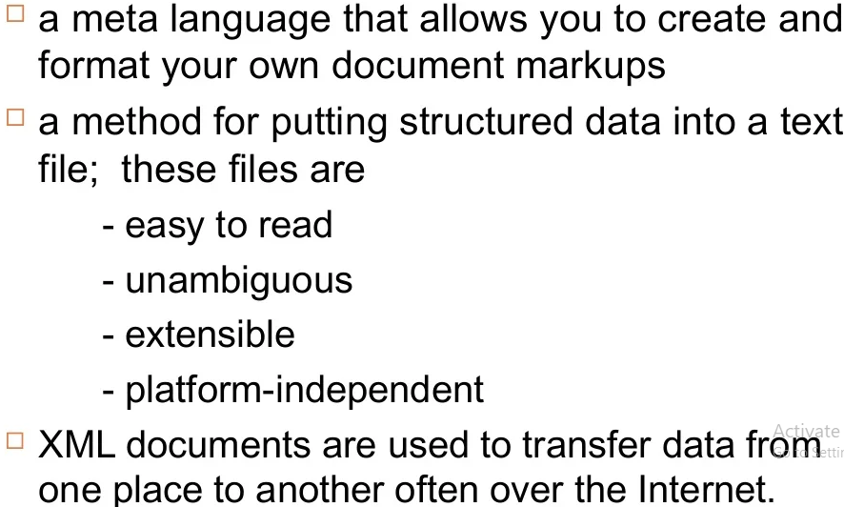
What is xml?

Slide 4
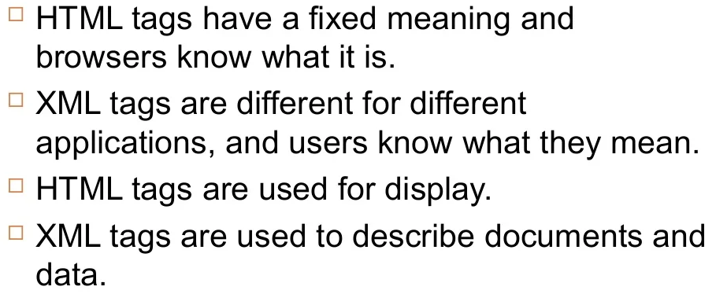
Difference between html and xml

Slide 5
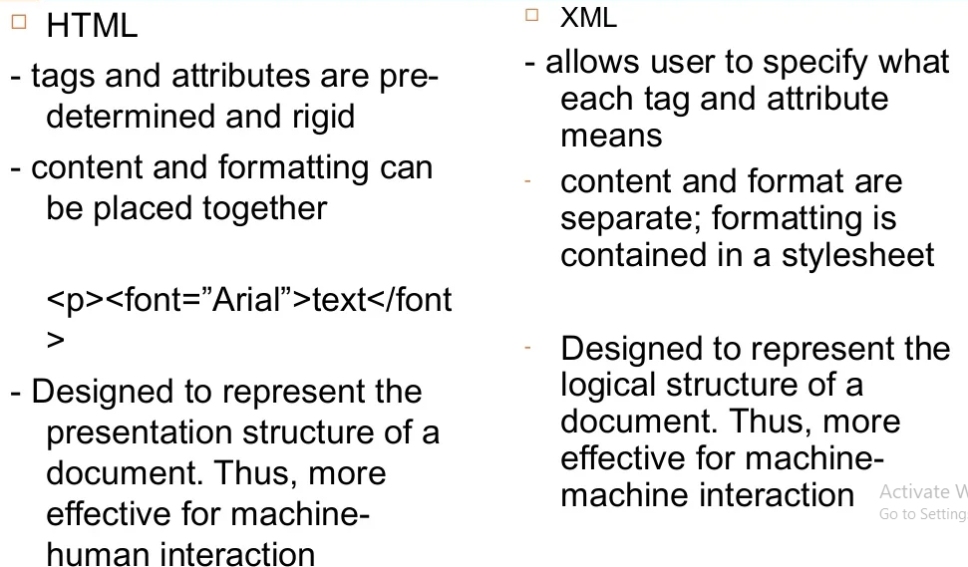
comparison

Slide 6
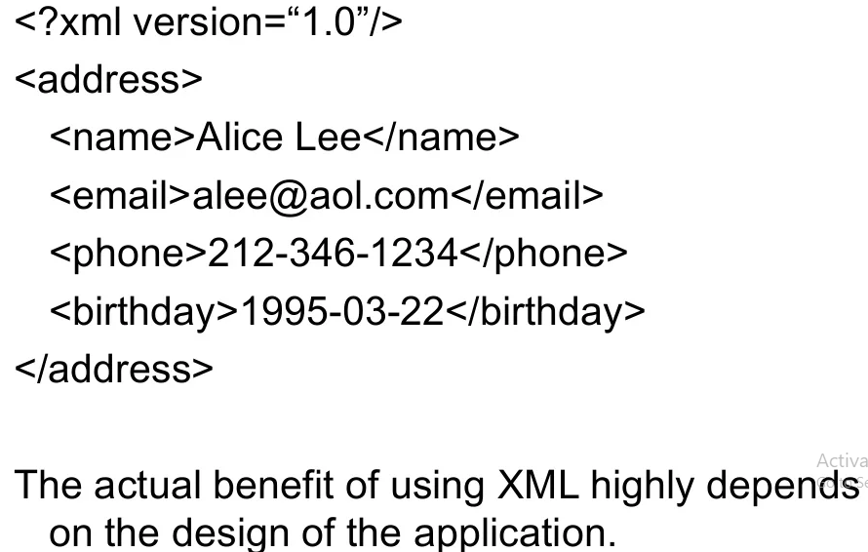
Coding Schema

Slide 7
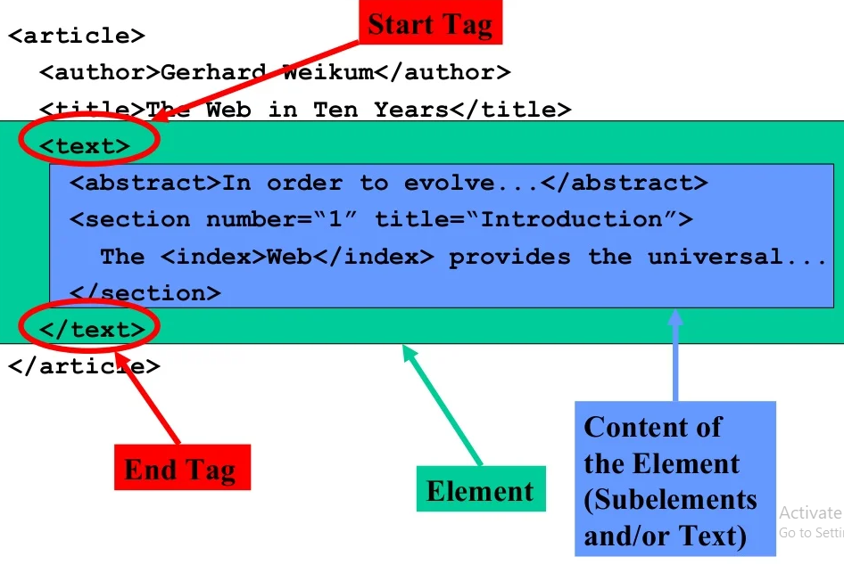
Simple xml document

Slide 8
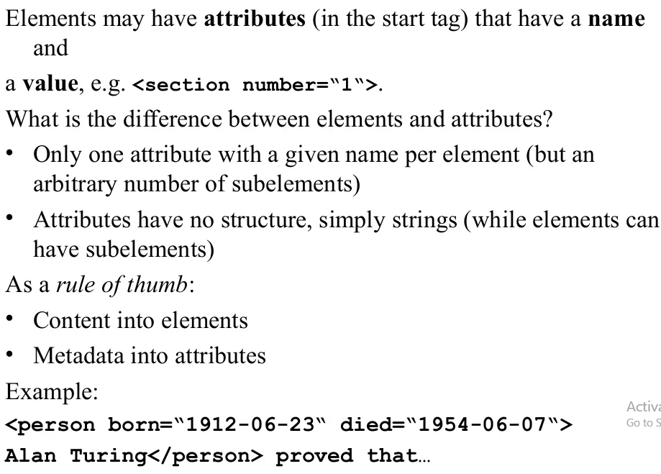
Elements vs attribute

Slide 9
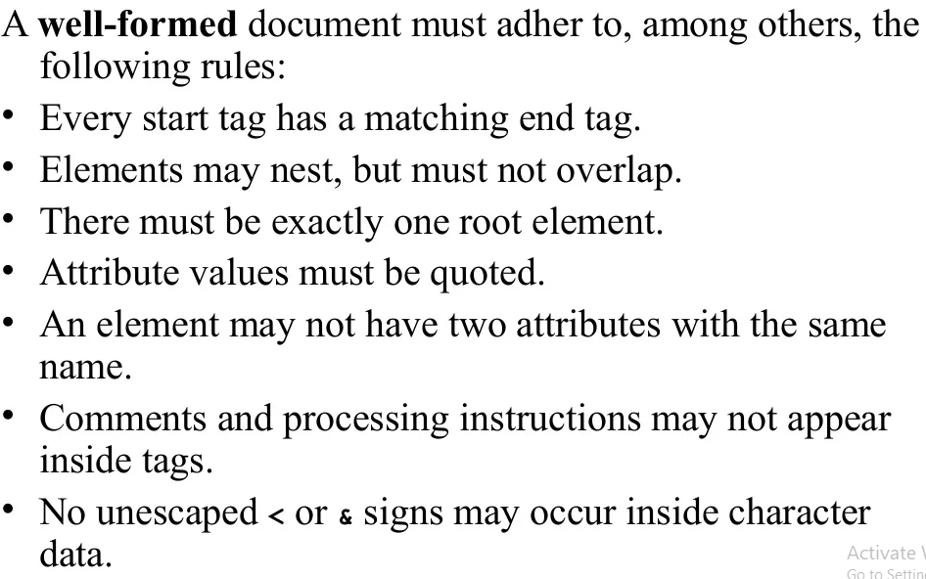
Well formed xml document

Slide 10
DTD XSD & RSS
DTD (Document Type Definition)
XSD (XML Schema Definition)
RSS (Really Simple Syndication) *republish

Slide 11
What is DTD and Why use DTD?
A DTD is a Document Type Definition.
A DTD defines the structure and the legal elements and attributes of an XML document.
With a DTD, independent groups of people can agree on a standard DTD for interchanging data.
An application can use a DTD to verify that XML data is valid.
If the DTD is declared inside the XML file, it must be wrapped inside the <!DOCTYPE> definition:
https://www.truugo.com/xml_validator/
https://www.freeformatter.com/xsd-generator.html#before-output
https://www.freeformatter.com/xml-validator-xsd.html

Slide 12
XML Document
<?xml version="1.0"?> <!DOCTYPE note [ <!ELEMENT note (to,from,heading,body)> <!ELEMENT to (#PCDATA)> <!ELEMENT from (#PCDATA)> <!ELEMENT heading (#PCDATA)> <!ELEMENT body (#PCDATA)> ]>
!DOCTYPE note defines that the root element of this document is note
!ELEMENT note defines that the note element must contain four elements: "to,from,heading,body"
!ELEMENT to defines the to element to be of type "#PCDATA"
!ELEMENT from defines the from element to be of type "#PCDATA"
!ELEMENT heading defines the heading element to be of type "#PCDATA"
!ELEMENT body defines the body element to be of type "#PCDATA"

Slide 13
XSD XMl schema definition
XML Schema Definition or XSD is a recommendation by the World Wide Web Consortium (W3C) to describe and validate the structure and content of an XML document. It is primarily used to define the elements, attributes and data types the document can contain. The information in the XSD is used to verify if each element, attribute or data type in the document matches its description.
An XSD is similar to earlier XML schema languages, such as Document Type Definition (DTD), but it is a more powerful alternative as it provides greater control over the XML structure.

Slide 14
Xml schema definition
As the language of the XML schema, XSD is similar to a database schema that describes the data within a database. It defines the building blocks of an XML document, including:
its attributes and elements;
the number and order of child elements;
the corresponding data types of multiple elements and attributes; and
the default and fixed values for elements and attributes.

Slide 15
XSLT – Extensible style-sheet language
XSL (eXtensible Stylesheet Language) is a styling language for XML.
XSLT stands for XSL Transformations.
<?xml version="1.0"?> <xsl:stylesheet version="1.0“ xmlns:xsl="http://www.w3.org/1999/XSL/Transform"> <xsl:template match="/">

Slide 16
What is X-path
XPath is a major element in the XSLT standard.
XPath can be used to navigate through elements and attributes in an XML document.
XPath stands for XML Path Language
XPath uses "path like" syntax to identify and navigate nodes in an XML document
XPath contains over 200 built-in functions
XPath is a major element in the XSLT standard
XPath is a W3C recommendation

Slide 17
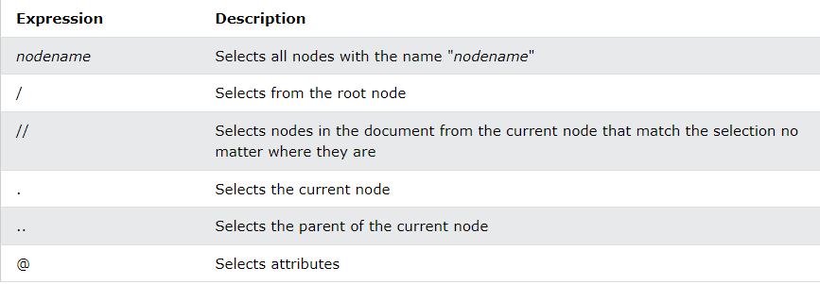
X-path syntax

Slide 18
X-query
XQuery is to XML what SQL is to databases.
XQuery is designed to query XML data.
XQuery is the language for querying XML data
XQuery for XML is like SQL for databases
XQuery is built on XPath expressions
XQuery is supported by all major databases
XQuery is a W3C Recommendation
XQuery can be used to:
Extract information to use in a Web Service
Generate summary reports
Transform XML data to XHTML
Search Web documents for relevant information

Slide 19
Rss Feed and Plugins

